Slide 1
APOD
ROBOTIC

Slide 2
Introduce
Hexapod
Apod
What’s Include?
Servos
Modules Control
SSC32
STM32F4
PC Control Interface
How’s difference?
What did they do?
What did we do?
How do we do?
Algorithm
Demo
Pros and cons
Are there anything to be programmed in the future?

Slide 3
INTRODUCE

Slide 4
Hexapod
A hexapod robot is a mechanical vehicle that walks on six legs. Since a robot can be statically stable on three or more legs, a hexapod robot has a great deal of flexibility in how it can move.
Many hexapod robots are biologically inspired by Hexapoda locomotion.
Uses:
Test biological theories about insect locomotion.
Motor control.
Neurobiology.

Slide 5
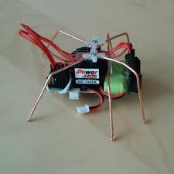
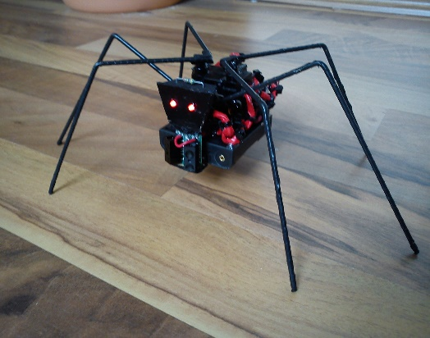
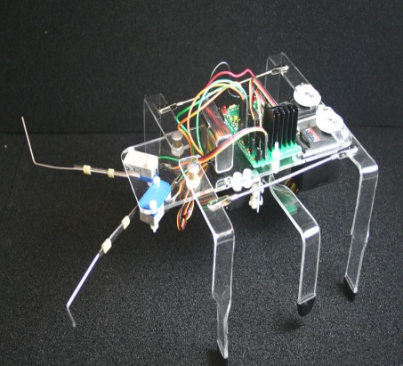
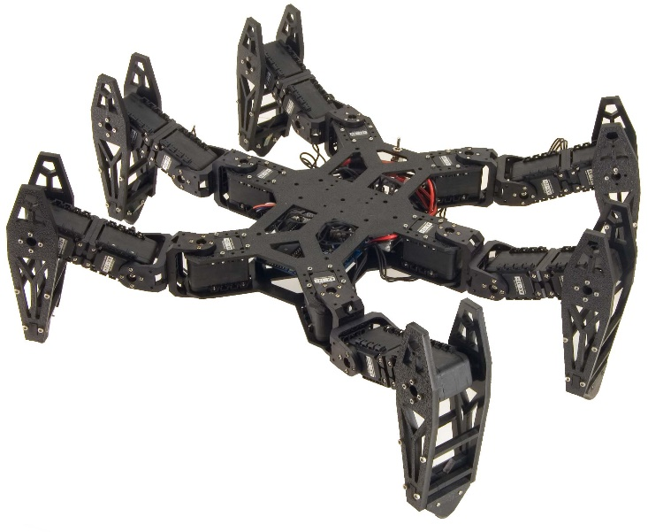
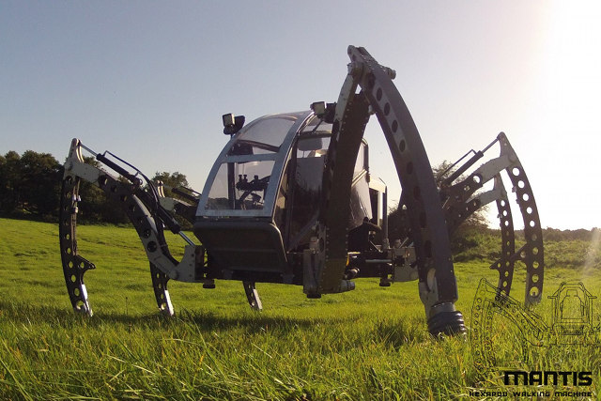
World of Hexapod

Slide 6
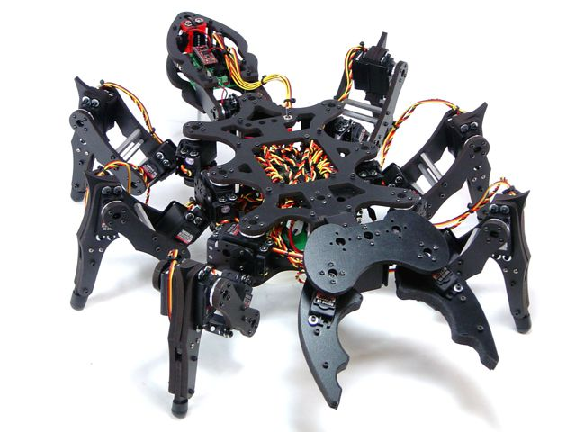
What is our project?
Hexapod
APOD

Slide 7
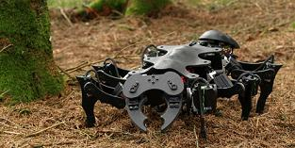
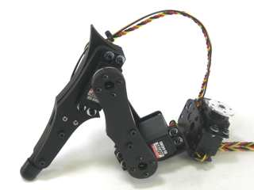
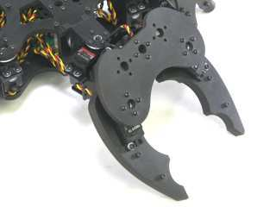
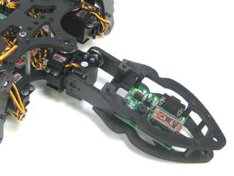
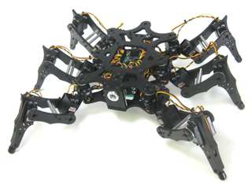
Apod
This is 3DOF hexapod.
Prototype of incest robot.
Include:
6 legs.
1 head with Gripper.
1 tail.
1 body
25 Servos
3 Servos/ Leg
3 Servos
Vertical
Horizontal
Rotate
2 Servos

Slide 8
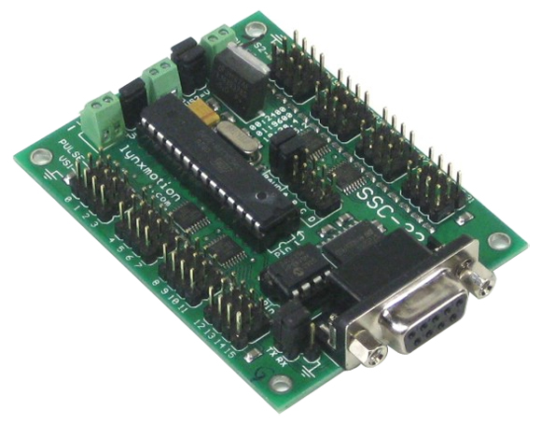
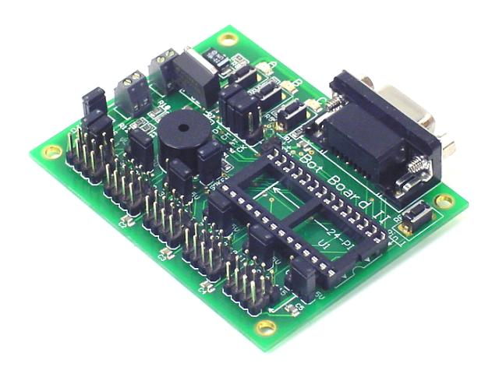
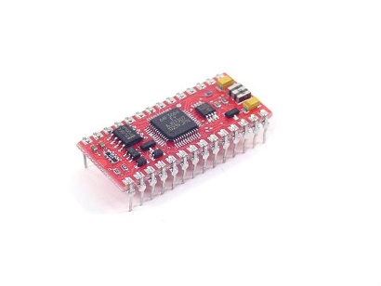
Their Apod
SSC32

Slide 9
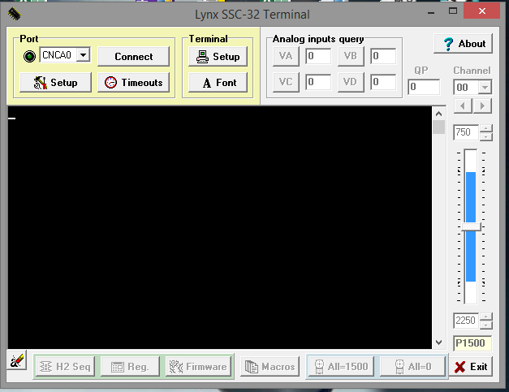
Their Apod

Slide 10
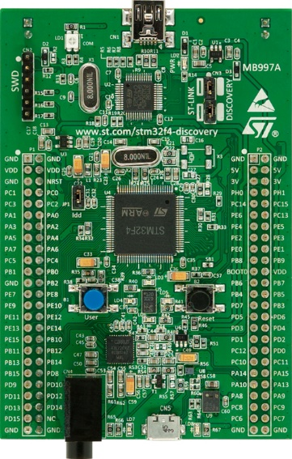
Our Apod
SSC32
STM32F4

Slide 11
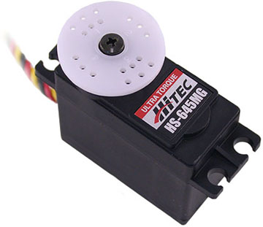
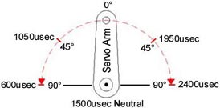
Servos
Control System: +Pulse Width Control 1500usec Neutral
Required Pulse: 3-5 Volt Peak to Peak Square Wave
Operating Voltage: 4.8-6.0 Volts Operating Angle: 45 Deg. one side pulse traveling 400usec

Slide 12

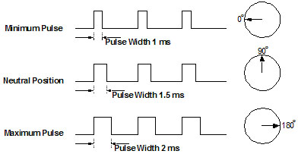
How’s Servo works?

Slide 13
Module Control
SSC32
STM32F4 DISCOVERY

Slide 14
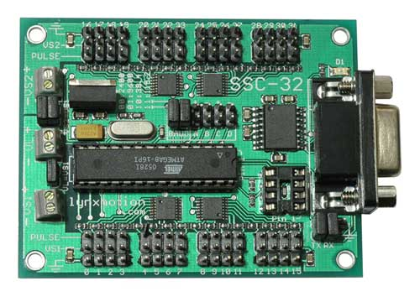
SSC32
Microcontroller = Atmel ATMEGA168-20PU
EEPROM = 24LC32P (Required for 2.01GP)
Speed = 14.75 MHz
Internal Sequencer = 12 Servo Hexapod (Alternating Tripod)
Serial input = True RS-232 or TTL, 2400, 9600, 38.4k, 115.2k, N81
Outputs = 32 (Servo or TTL)
Inputs = 4 (Static or Latching, Analog or Digital)
Current requirements = 31mA
PC interface = DB9F
Microcontroller interface = Header posts
Servo control = Up to 32 servos plug in directly
Servo type supported = Futaba or Hitec
Servo travel range = 180°
Servo resolution = 1uS, .09°
Servo speed resolution = 1uS / Second
Servo motion control = Immediate, Timed, Speed or Synchronized.
PC board size = 3.0" x 2.3"
VS current capacity = 15 amps per side, 30 amps max

Slide 15
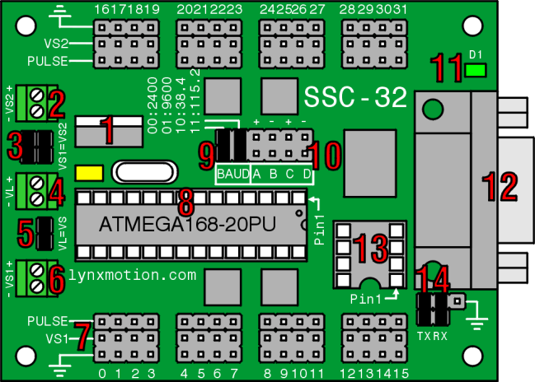
SSC32

Slide 16
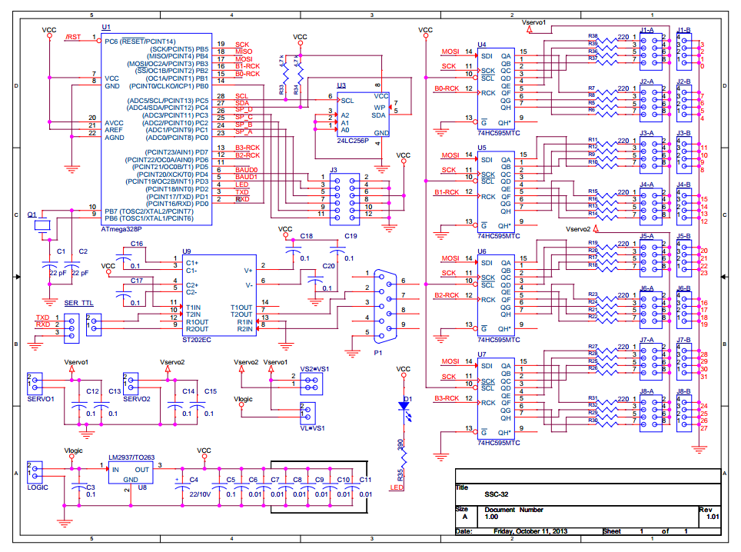
SSC32

Slide 17
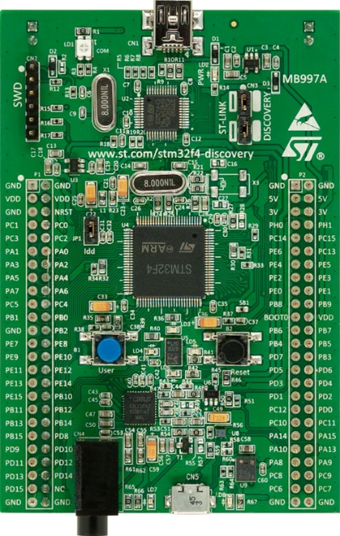
STM32F4
STM32F407VGT6 microcontroller featuring 32-bit ARM Cortex-M4F core,
1 MB Flash, 192 KB RAM in an LQFP100 package
On-board ST-LINK/V2 with selection mode switch to use
the kit as a standalone ST-LINK/V2 (with SWD connector for programming and debugging)
Board power supply: through USB bus or from an external 5 V supply voltage
External application power supply: 3 V and 5 V
LIS302DL or LIS3DSH ST MEMS 3-axis accelerometer
MP45DT02, ST MEMS audio sensor, omni-directional digital microphone
CS43L22, audio DAC with integrated class D speaker driver
Eight LEDs:
LD1 (red/green) for USB communication
LD2 (red) for 3.3 V power on
Four user LEDs, LD3 (orange), LD4 (green), LD5 (red) and LD6 (blue)
2 USB OTG LEDs LD7 (green) VBus and LD8 (red) over-current
Two push buttons (user and reset)
USB OTG FS with micro-AB connector
Extension header for all LQFP100 I/Os for quick connection to prototyping
board and easy probing

Slide 18
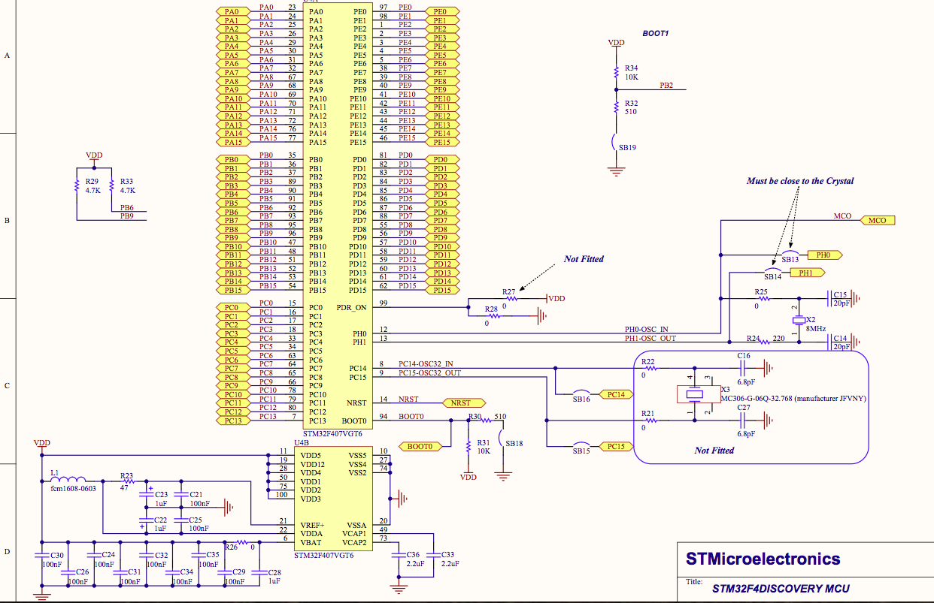

Slide 19
PC INTERFACE

Slide 20
How’s difference?

Slide 21
What did they do?
Apod
Movement (Left, Right,Forward, Backward, etc.)
Grip
Lift
Drop
Some crazy action
Controller
Using Wireless controller (2.4Ghz) direct connect with BOTII module
Brain
All algorithm embedded in BOTII
Another function
NONE

Slide 22
What did they do?
(Video here)

Slide 23
What did we do?
Apod
Movement (Left, right, forward, backward, etc.)
Grip
Lift
Drop
Some crazy action
Controller
Using Bluetooth connect indirect through Pc interface, communicate with STM32F4
Brain
All algorithm embedded in STM32F4 discovery

Slide 24
What did we do? (cont)
Another function
Live camera with detect color
Automate redirect movement
Automate indentify distance between Apod and the item

Slide 25
Does we similar with others?
NO
Built all implement from the begin
Firmware (SSC32)
Alternate module (STM32F4)
Just:
Depend on Algorithm which World’s done to create function

Slide 26
What did we do? (cont)
Clip here

Slide 27
How do we do?

Slide 28
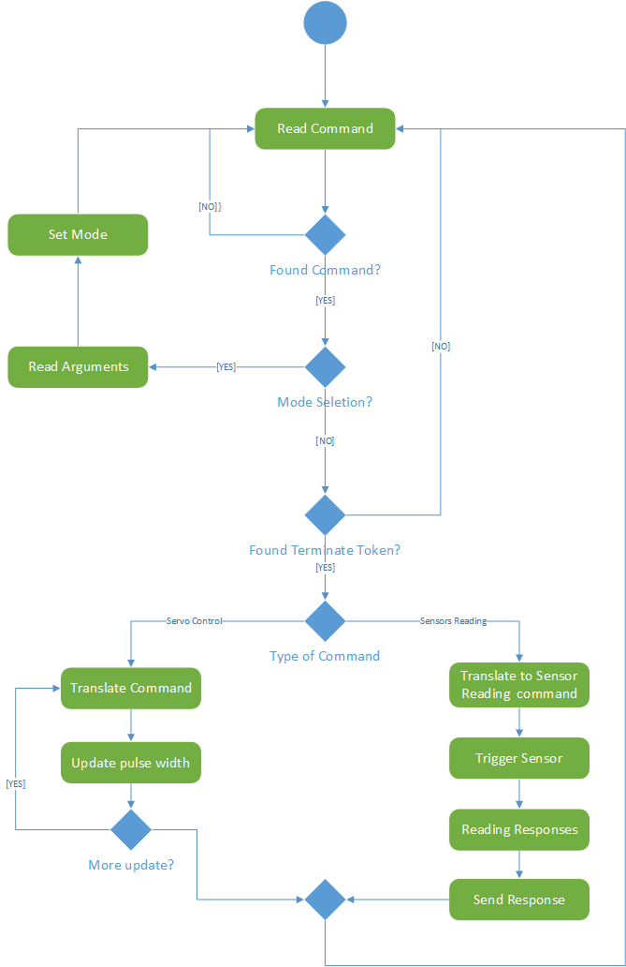
SSC32 Flowchart

Slide 29
Demo

Slide 30
Pros and cons
Short time to program
Hard to find hardware

Slide 31
Are there anything to be programmed in the future?
Automate in movement like the insect
Tracking function and find the way to return
Can hear and make some dancing in music
Able to walk on stair
Obey (can follow the owner, hear the order of owner, etc.)

